Slide 1
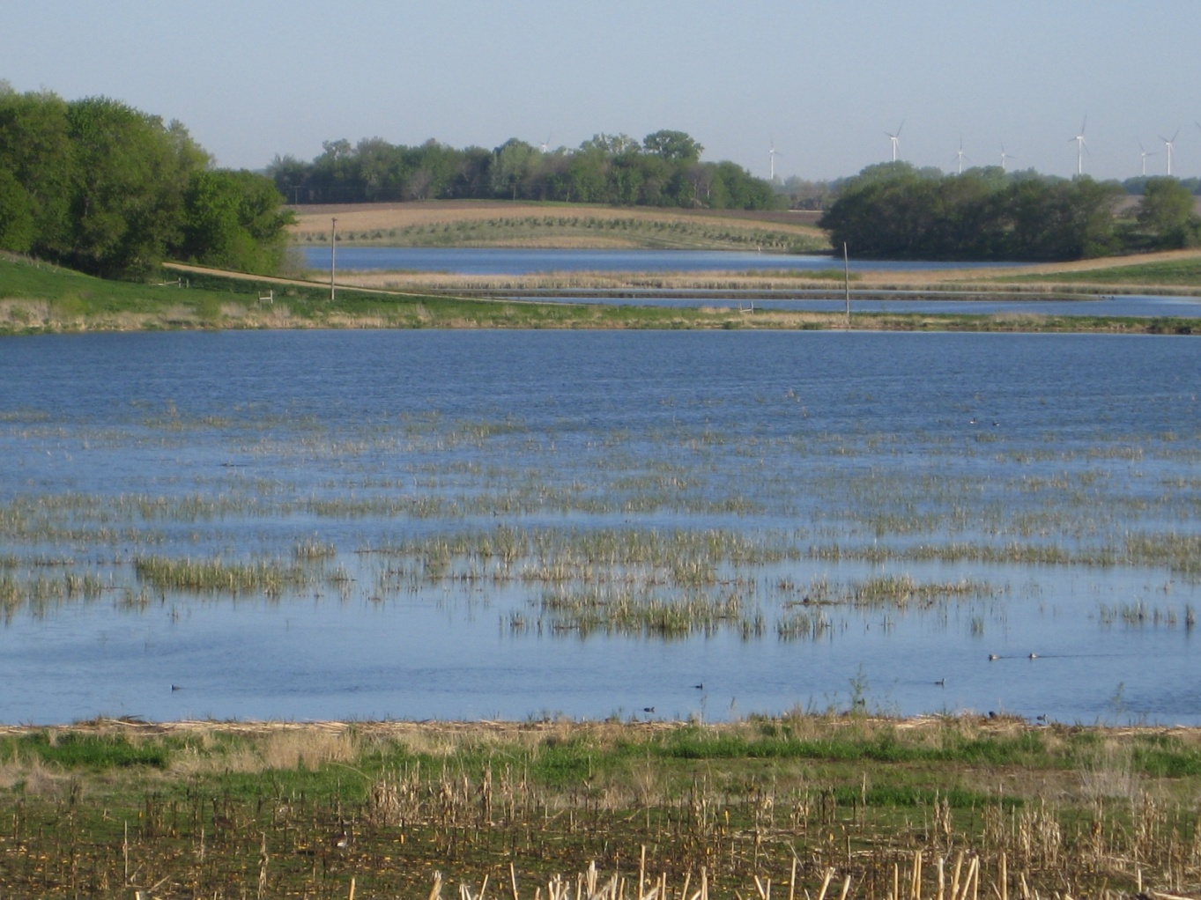
Water storage in the Minnesota River
Dr. Karen Gran
Earth & Environmental Sciences
University of Minnesota Duluth
December 2019
Photo from Elm Creek Restoration Project
Lenhart, Brooks, and Magner

Slide 2
How is hydrology changing in MN River?
Annual flow metrics normalized by the 1950–2010 mean. Data from 12 gages on Minnesota River.
Kelly et al., 2017

Slide 3
How is hydrology changing in Red River?
Kelly et al., 2017

Slide 4
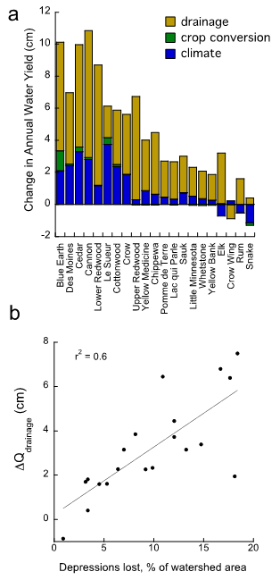
Why is hydrology changing?
Drainage and Climate
1940
2012
Schottler et al., 2013
Kelly et al., 2017

Slide 5
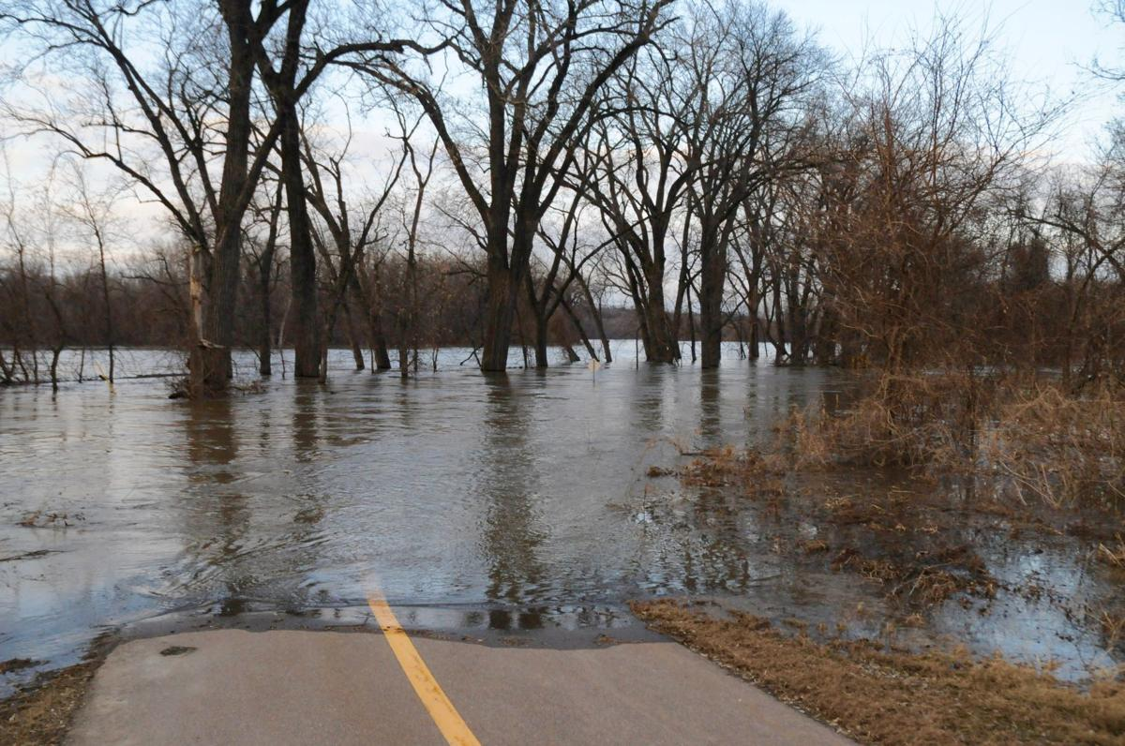
Why are higher flows a problem?
Flooding
Erosion
  Infrastructure damage
  Sediment loading
Photo by SWNews.com

Slide 6
What is the value of water storage?
REDUCE Flooding
REDUCE Erosion
  Infrastructure damage
  Sediment loading
REDUCE Nutrient export
Photo by SWNews.com

Slide 7
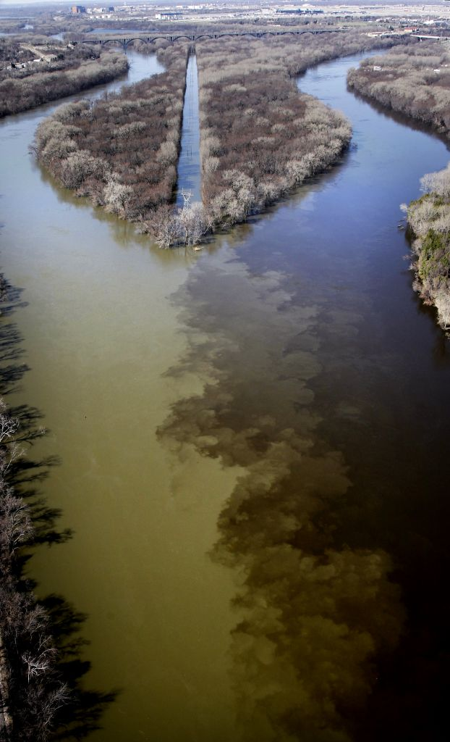
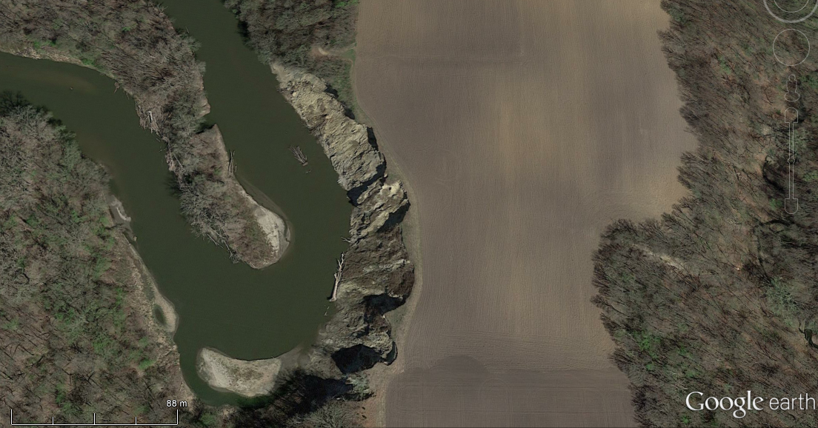
MN River is sensitive to increases in flow.
Mississippi
Minnesota
There is a tight connection between hydrology and erosion that is related to the geomorphic history of the watershed.
Photo: Star Tribune

Slide 8
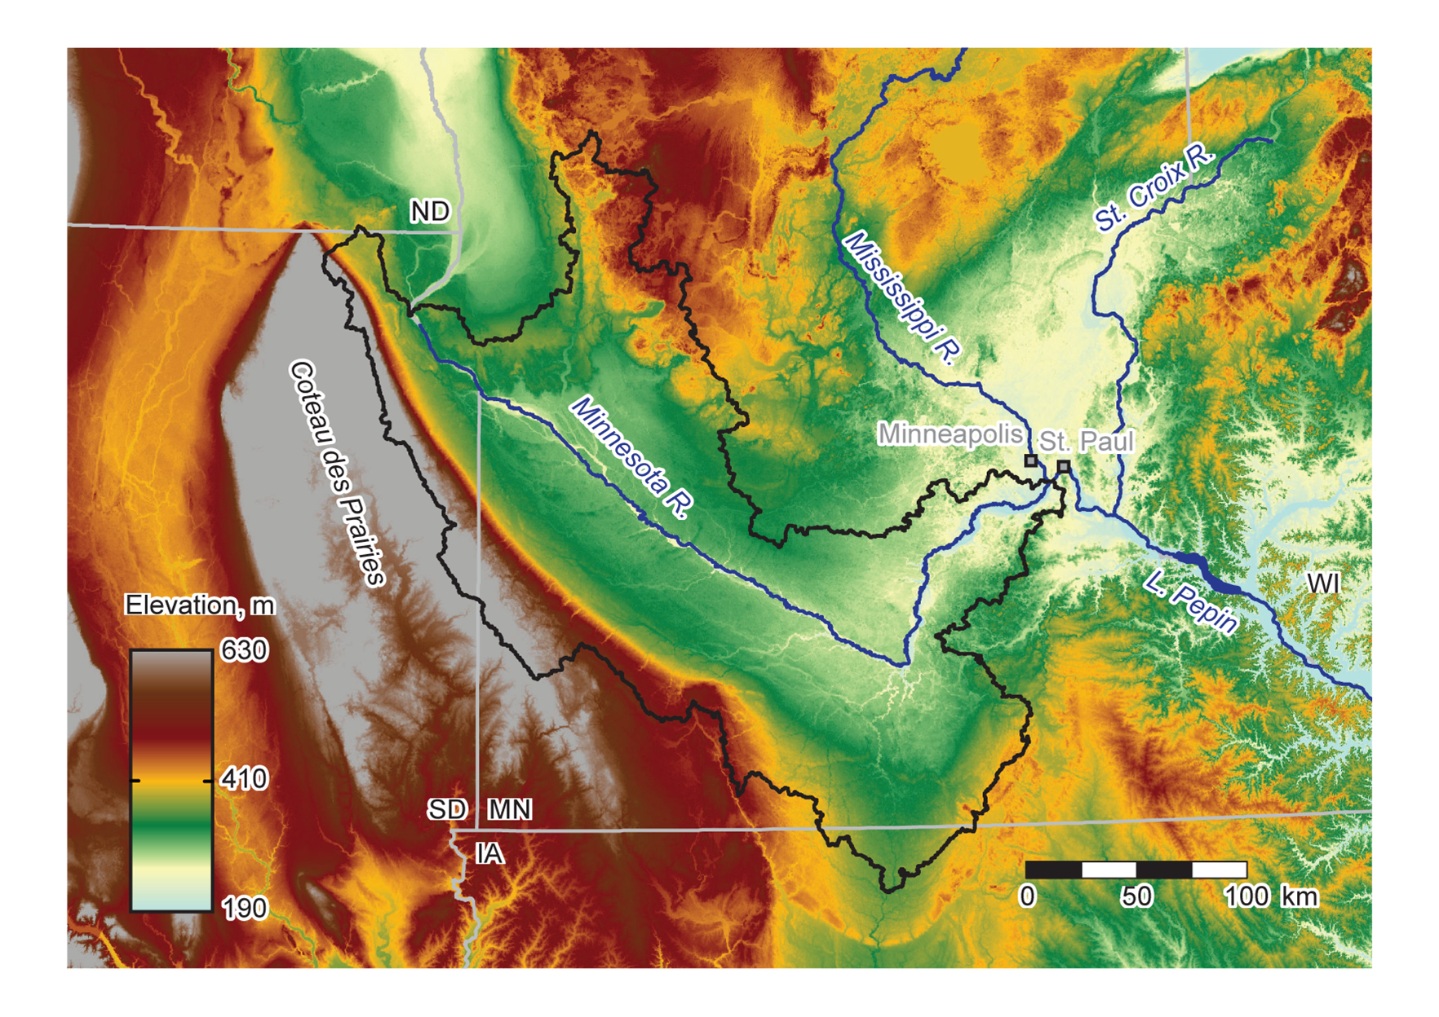
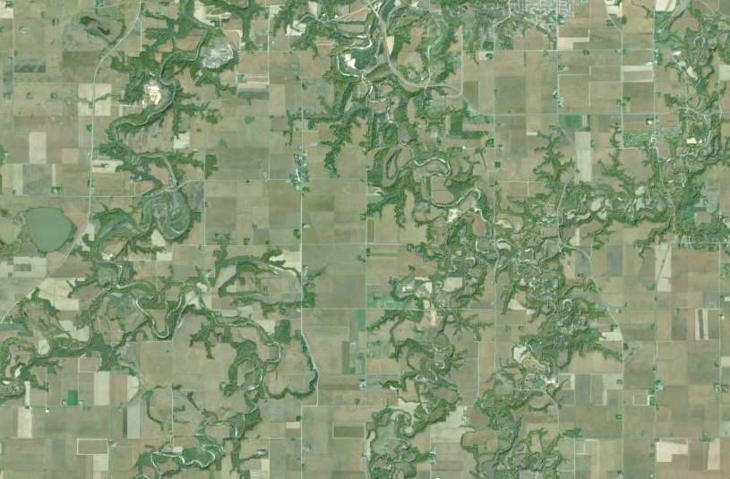
J. Czuba

Slide 9
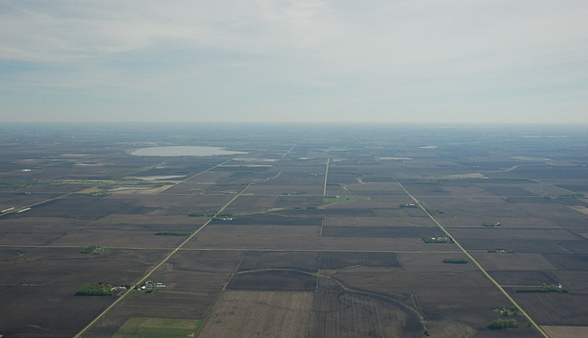
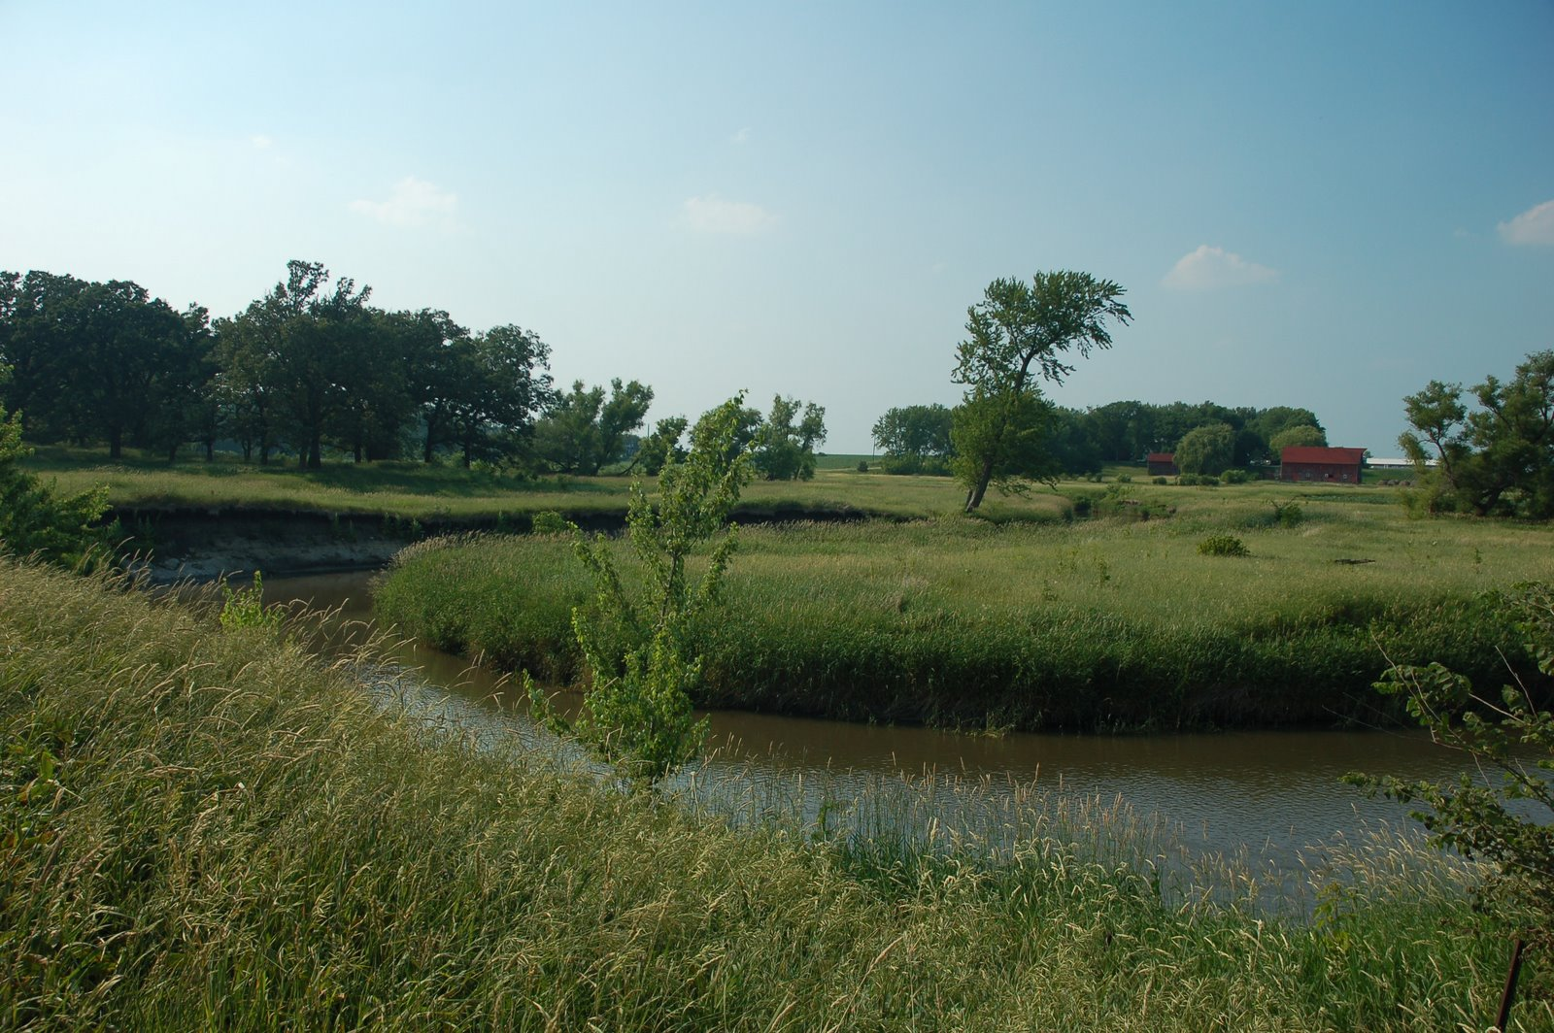
Above the knickpoint
Photos by Carrie Jennings

Slide 10
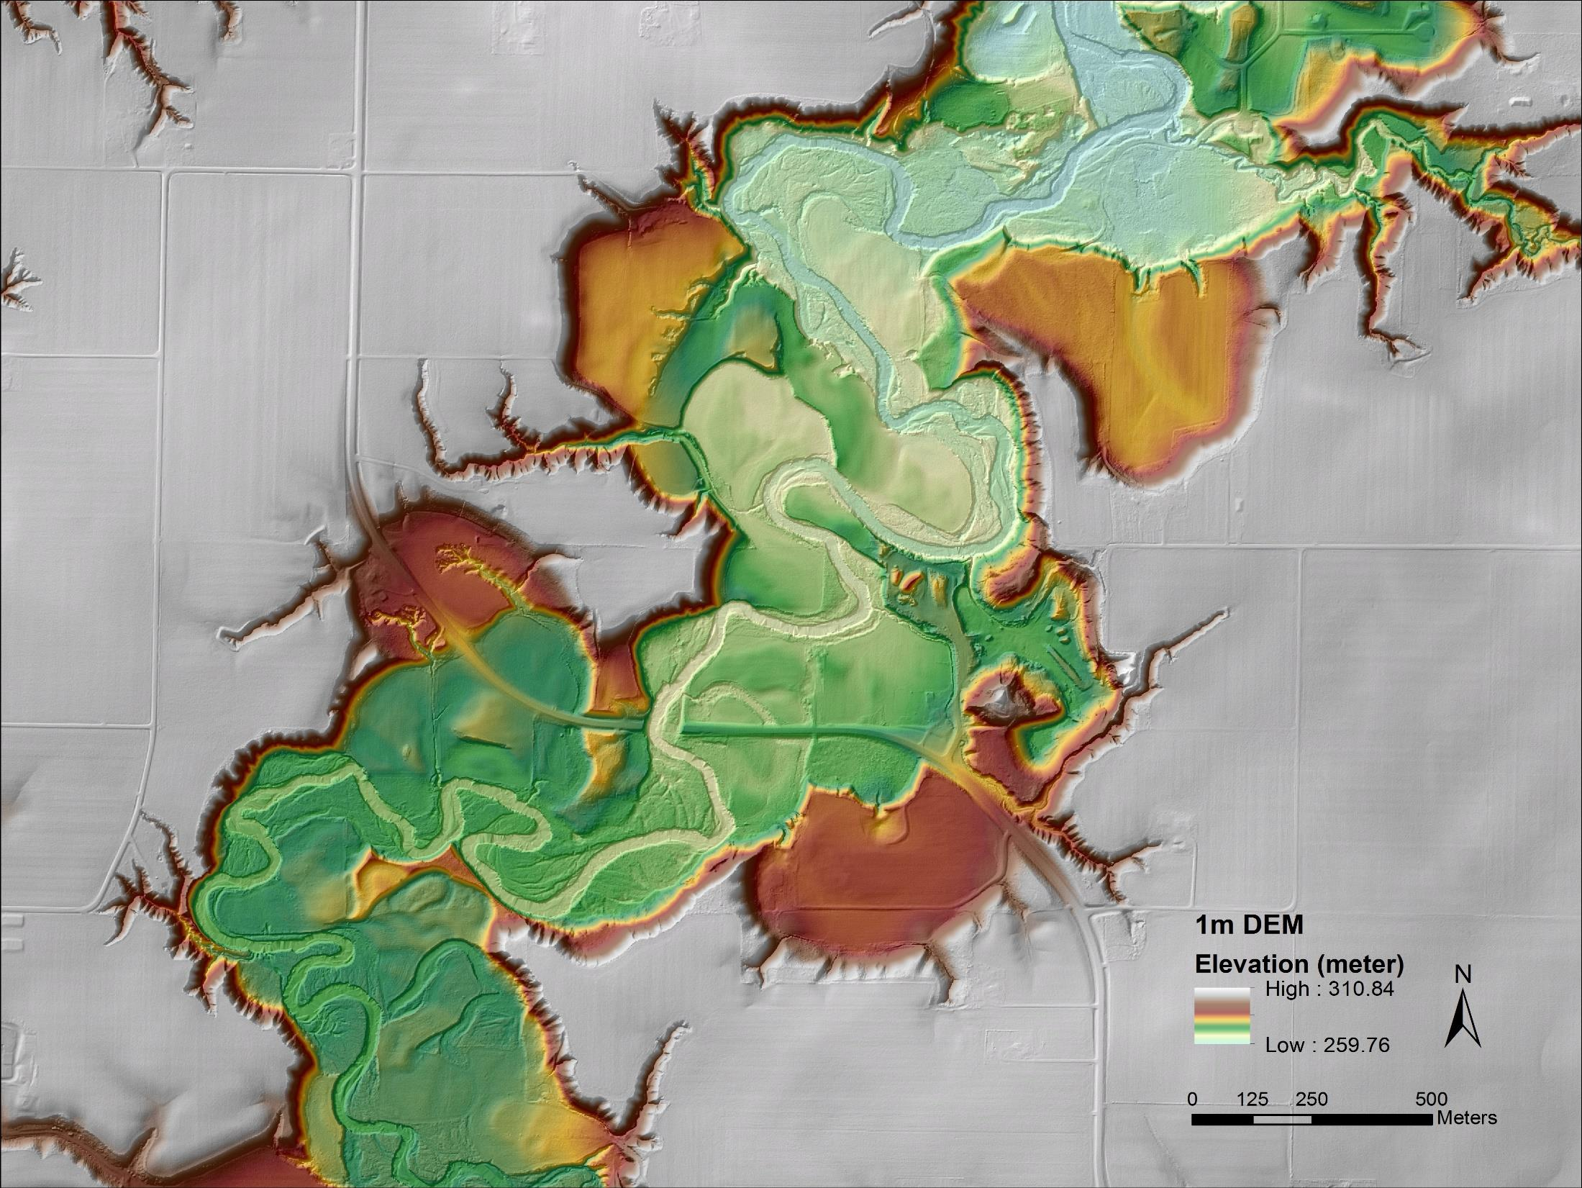
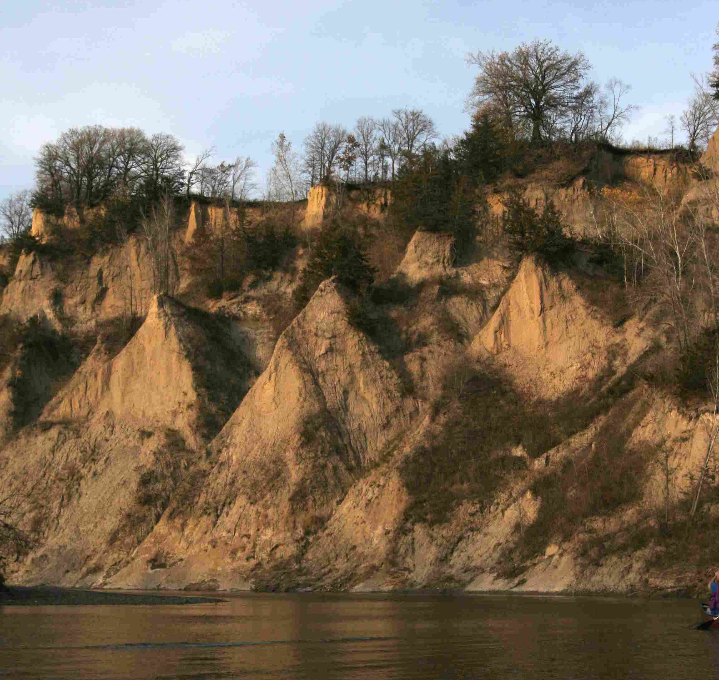
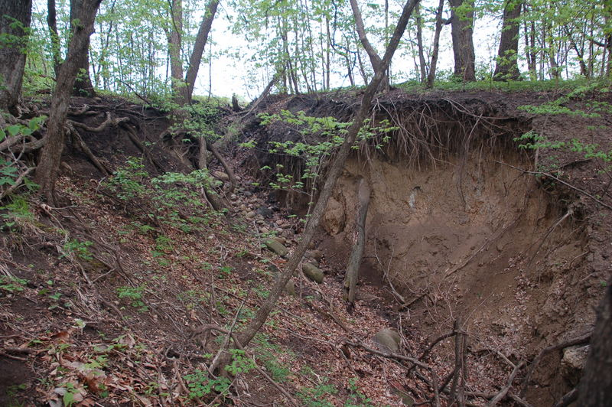
Below the
knickpoint
Photos by Carrie Jennings

Slide 11
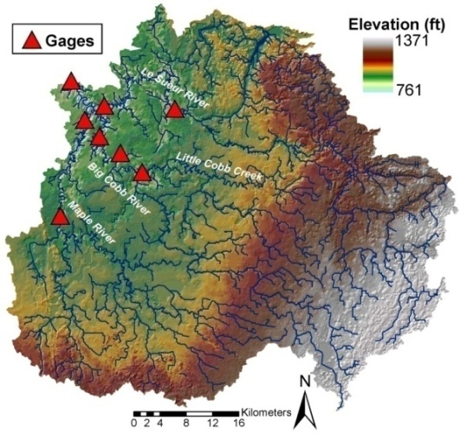
Where is sediment coming from?
Uplands
Below
Knickpoint
Bluffs
Ravines
Streambanks
Uplands
Ravines
Above
knickpoint
Streambanks
Bluffs
Floodplains
Lakes
Notes:
add land use- general and hi-res yields
surficial geology, soils maps
sediment loads

Slide 12
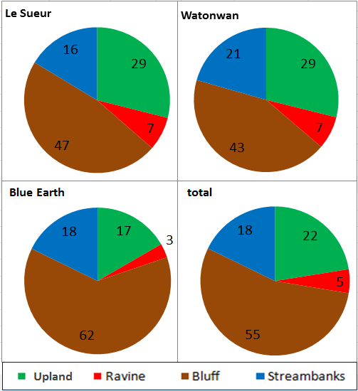
Sediment sources in Greater Blue Earth River Basin are predominantly related to near-channel erosion
Le Sueur
Watonwan
Blue Earth
Total (GBERB)
Upland
Ravine
Bluff
Streambanks

Slide 13
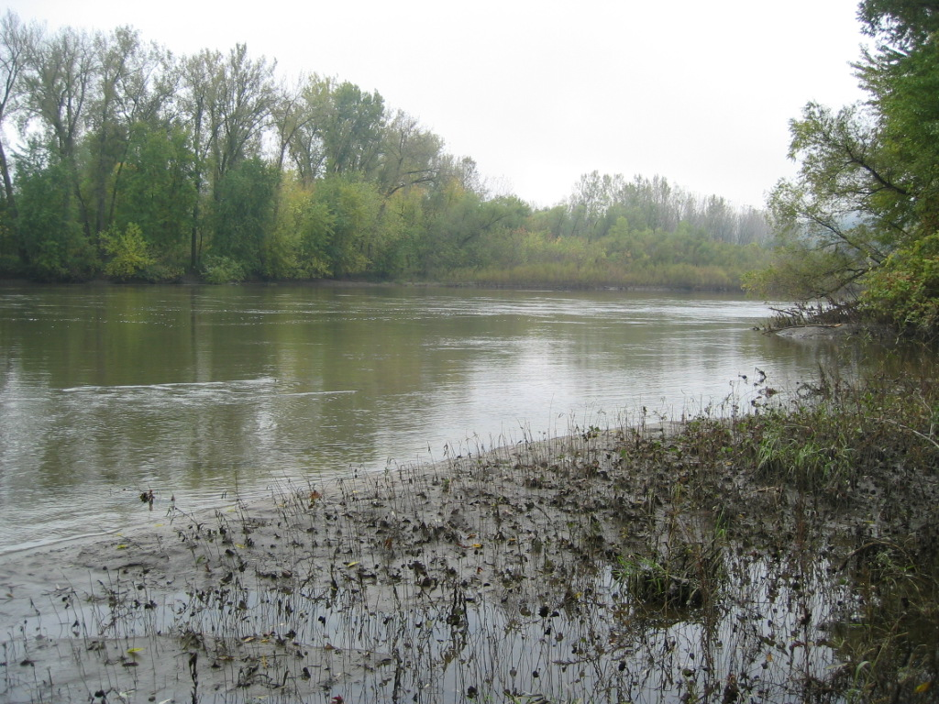
The amount of sediment has increased over time
Lake Pepin Record
2000
1900
Year
1800
Minnesota River
1700
Mississippi +
St. Croix Rivers
1600
1500
0
200
400
600
800
Sedimentation Rate (10³ Mg y⁻¹)
From Engstrom et al., 2009
Kelley & Nater,2000

Slide 14
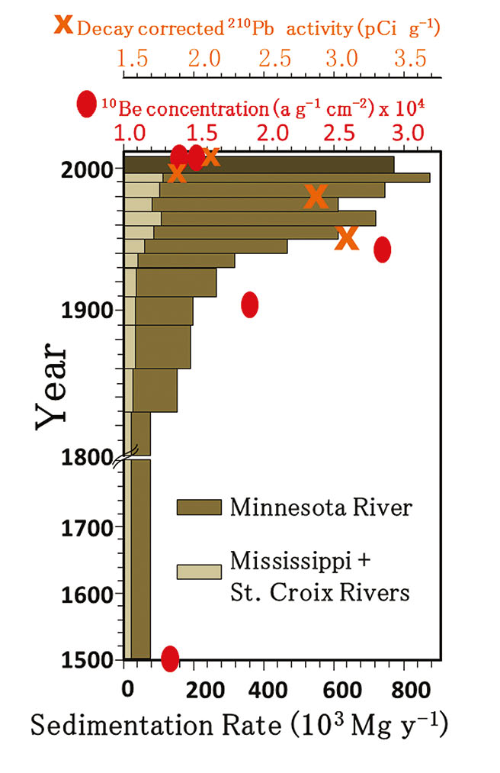
Sedimentation record with sediment fingerprinting data
Sediment loads stay high; Shift in sources back to non-field
Rise of agriculture; Increase in sedimentation; Shift in sources to predominantly field sediment
Pre-Euro settlement conditions; Most sediment derived from non-field sources
Low
% Field
High
Belmont et al. (2011)

Slide 15
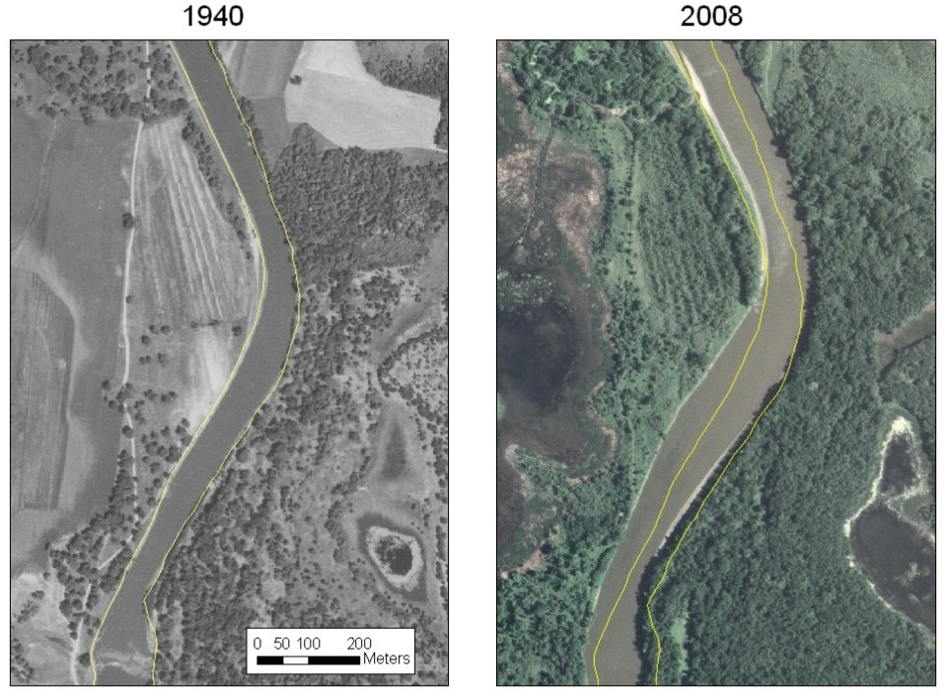
Geomorphic Response to changing flows
Rivers are getting wider over time
Figure from Wes Lauer

Slide 16
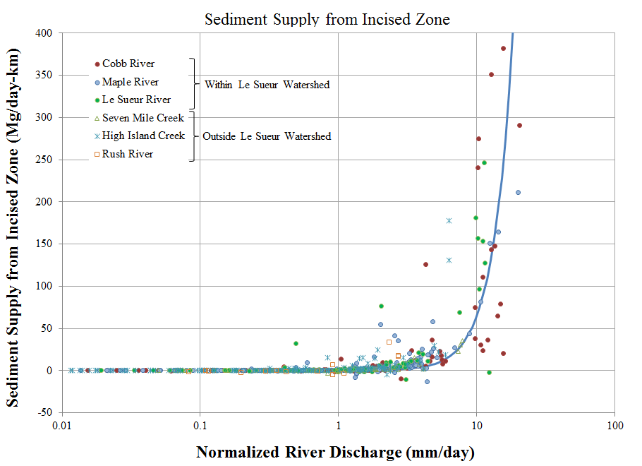
At what flows is erosion happening?
Sediment Supply from
Incised Zone (Mg/day/km)
Near-channel erosion rates increase at high flows.
If we can decrease flows, we can lower erosion rates along bluffs.
Normalized River Discharge (m³/s/km²)
Cho et al., 2019

Slide 17
At what flows is erosion happening?
Sediment Supply from
Incised Zone (Mg/day/km)
Near-channel erosion rates increase at high flows.
If we can decrease flows, we can lower erosion rates along bluffs.
Normalized River Discharge (m³/s/km²)
Cho et al., 2019

Slide 18
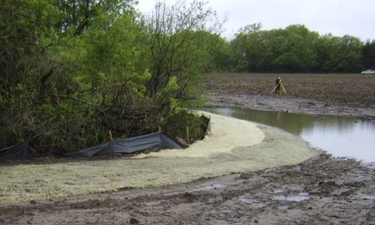
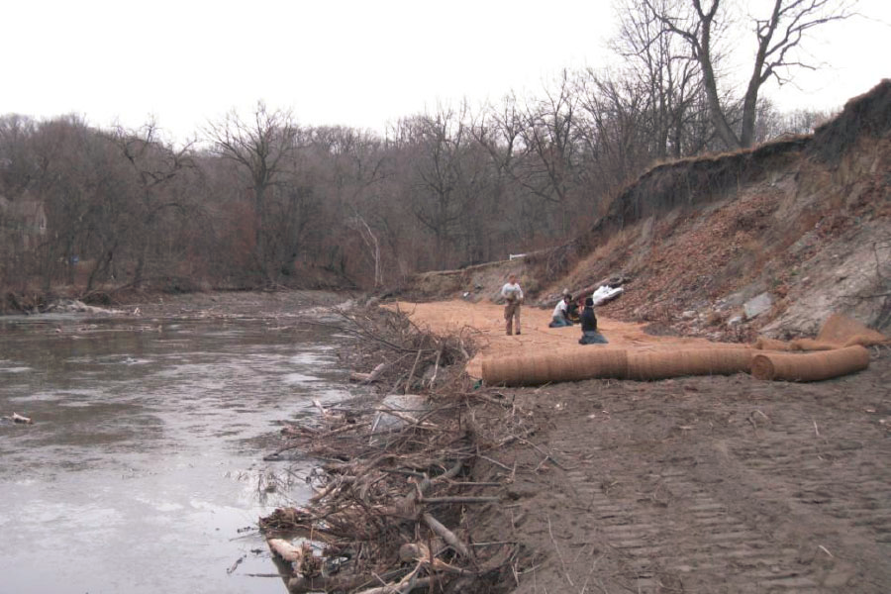
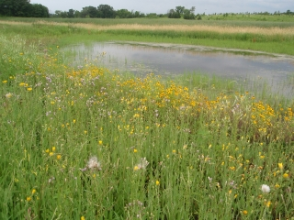
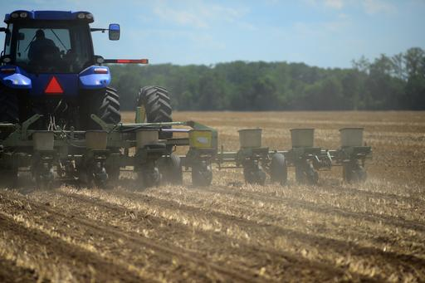
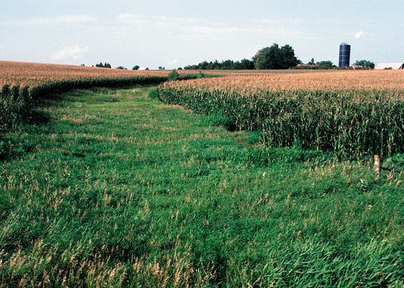
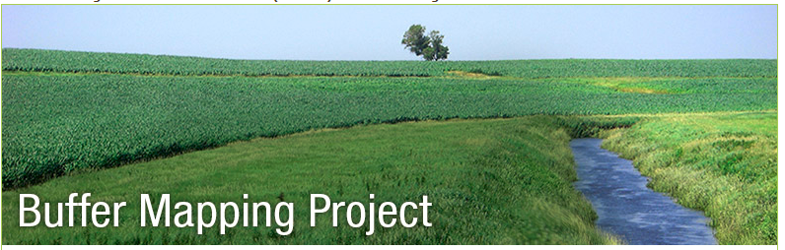
How can we reduce sediment loading?
Photo: StCroix360; Washington Conservation District
Lesueurriver.org
?
NRCS
Rice SWCD
MN DNR
Photo: Star Tribune
NRCS

Slide 19
CSSR
Collaborative for Sediment Source Reduction
Goal: To identify a consensus strategy for reducing sediment loading in the Greater Blue Earth watershed using a decision framework that incorporates the best available scientific information, accounts for uncertainty, and provides a model for decision making throughout the Minnesota River Basin.

Slide 20
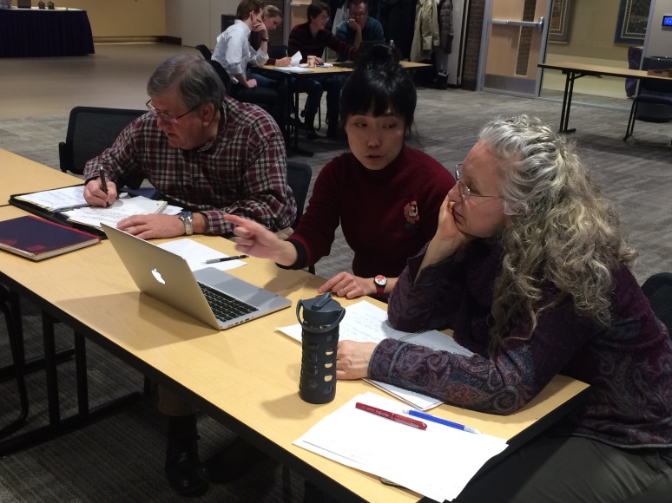
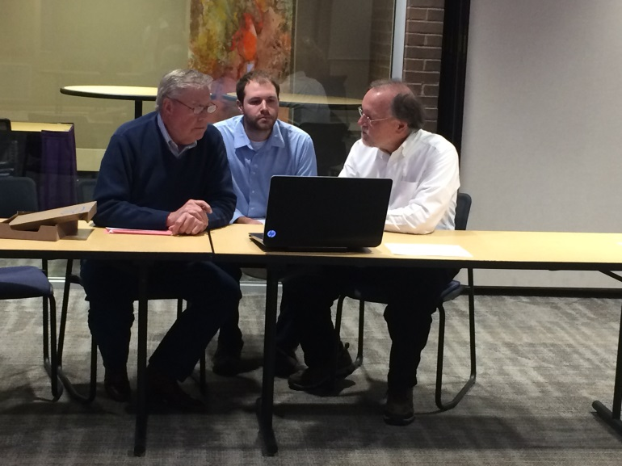
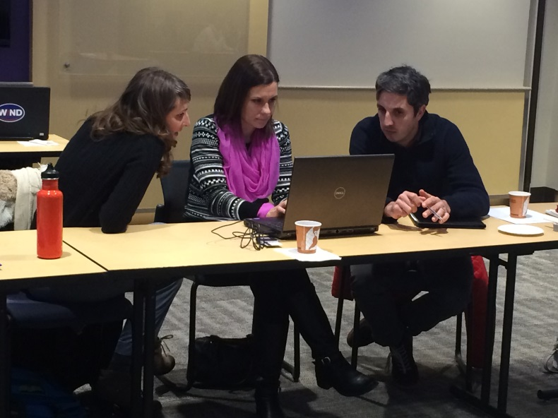
2012
2013
2014
2015
1
2
3
4
5
6
7
2016
2017
8
9
Stakeholder Group

Slide 21
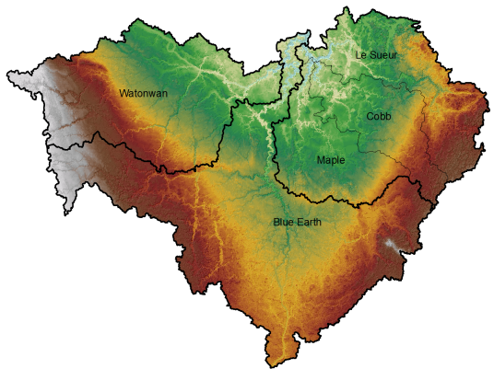
Collaborative for Sediment Source Reduction
Greater Blue Earth River
Management Option Simulation Model
User specifies management options:
Type, Extents, Rates, Costs
Route water and sediment downstream
Apply mgmt options on landscape
Determine costs
Determine sediment loads

Slide 22
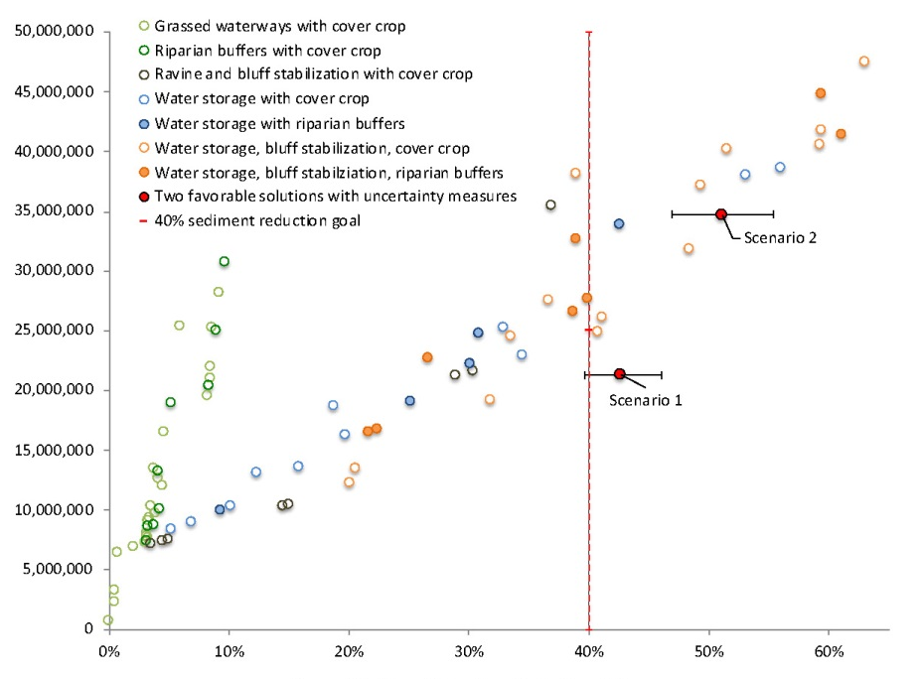
How do we get the most ‘bang for the buck’?
Green = buffers, grassed waterways
Blue = water storage
Orange = water storage + bluff stabilization
Costs
Annual Cost [$/yr]
Sediment load reduction
Annual Sediment Load Reduction [%]
Cho et al., 2019
Notes:
Scenario 1 includes 12,000 acres of water storage (about 20% of available candidate sites) and 24,000 m of bluff stabilization (about 30% of available candidate sites) and provides an annual sediment load reduction of 79,000 Mg (43% reduction) at an annual cost of $21 million. Scenario 2 increases acreage in water conservation to about 25% of available sites and river length in bluff stabilization to about 40% of available sites and incorporates cover crops to 30% of total agricultural land. This scenario produces an annual reduction in sediment loading of 95,000 Mg (51% reduction) at an annual cost of $35 million.

Slide 23
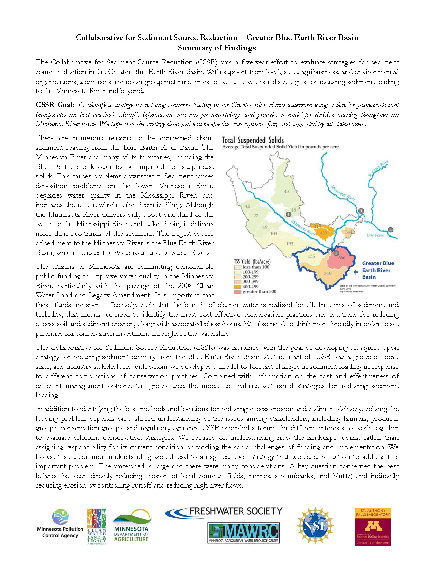
Consensus!
https://conservancy.umn.edu/handle/11299/191082

Slide 24
Summary of findings
1. Ravines that are large local sources of sediment can be targeted. Investment in stabilizing these ravines is worthwhile, but not sufficient to reduce sediment loading to meet water quality standards.

Slide 25
Summary of findings
2. Eroding bluffs that threaten infrastructure and produce exceptionally large amounts of sediment can be targeted. Investment in stabilizing these bluffs is worthwhile, but bluff stabilization is not the most effective solution for long-term reduction in sediment loading across the watershed.

Slide 26
Summary of findings
3. Achieving water quality standards will require priority investment in more temporary water storage to reduce high river flows and bluff erosion. This is a critical component of a strategy to reduce sediment in the Minnesota River.

Slide 27
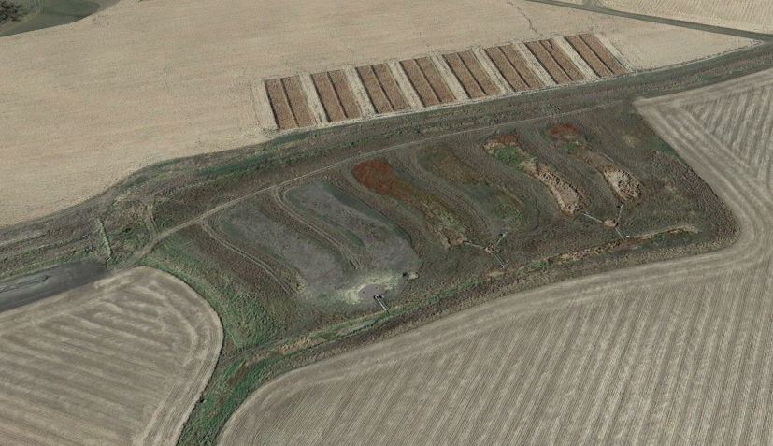
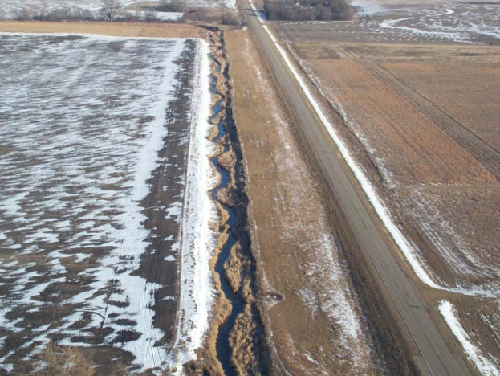
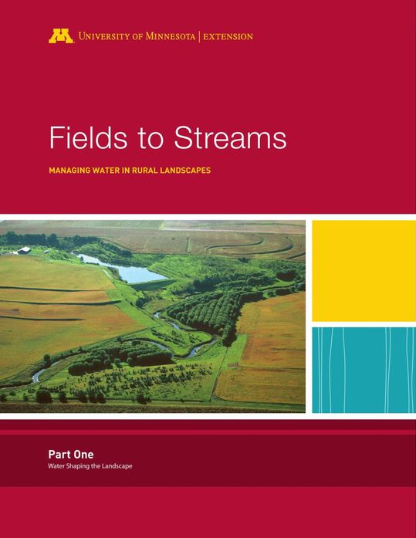
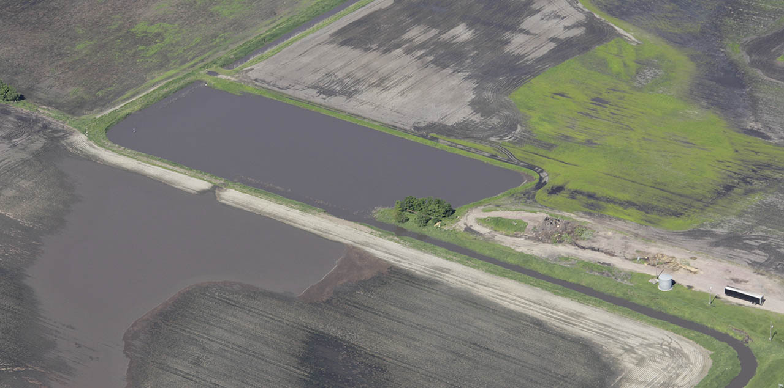
U of M Southwest Research and Outreach Center
Swift County JD 8 Restoration Project, Kriter, Magner and others
BE County Ditch 57 Restoration Project, ISG
Elm Creek Restoration Project, Lenhart, Brooks & Magner

Slide 28
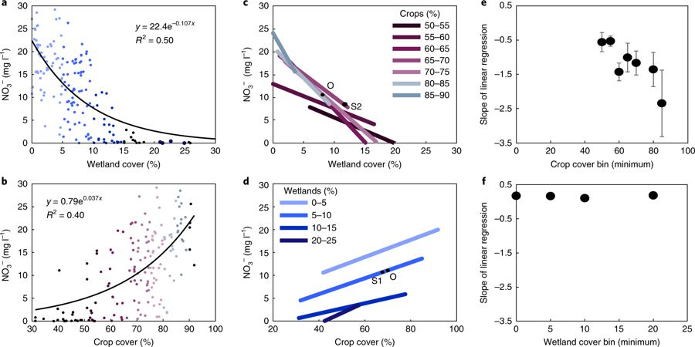
Wetlands also decrease nitrogen concentrations
Hansen et al., 2018
Nature Geoscience
Notes:
Le Sueur, Cottonwood, and Chippewa

Slide 29
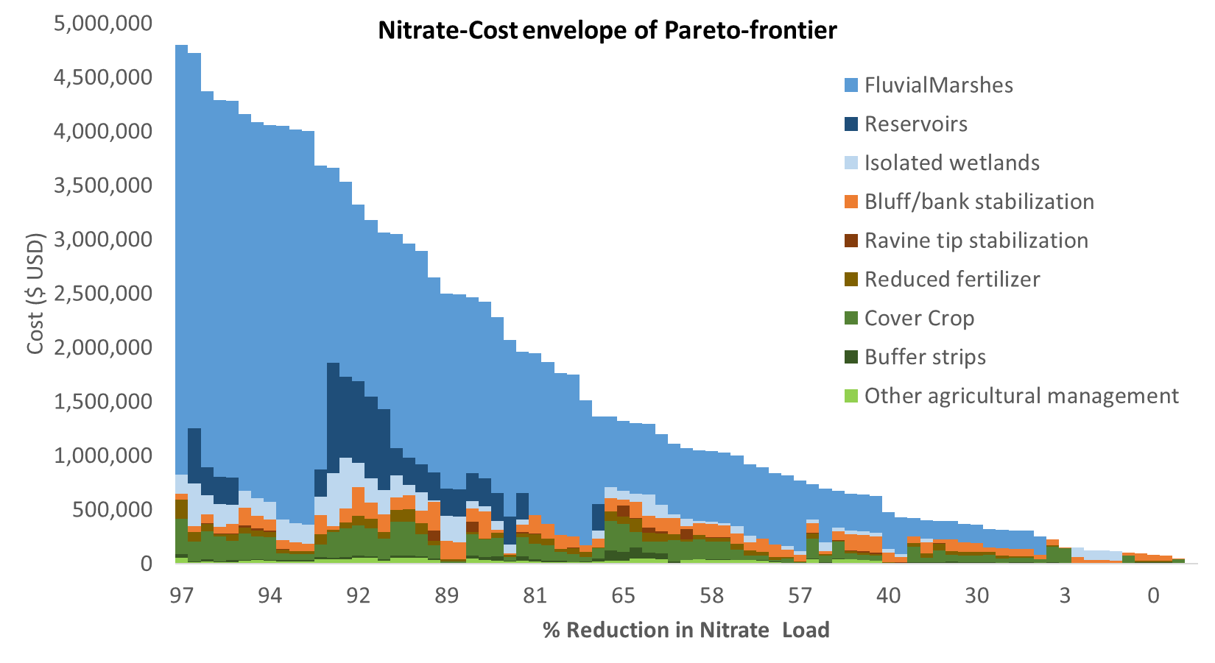
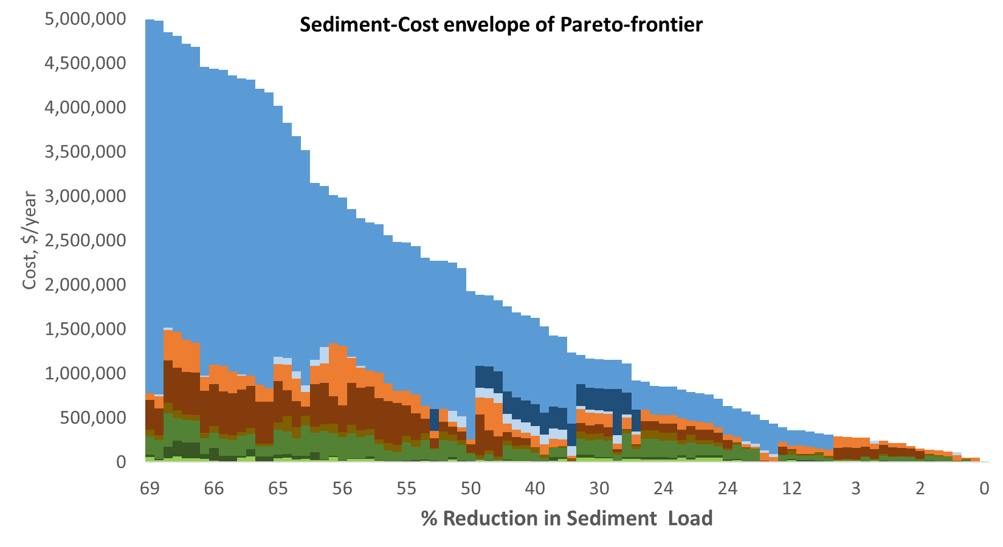
Field management
 | Cover crops
 | Grassed waterway
 | Fertilizer management
 | Isolated marsh
 | Isolated pond
Near channel management
 | Buffer strip
 | Reservoir
 | Fluvial marsh
 | Ravine tip stabilization
 | Bluff stabilization

Slide 30
Where do you install water storage?
MOSM explored large-scale placement Greater Blue Earth basin
SWAT model explored large-scale placement Le Sueur basin
Multi-model: sediment, nitrate in Le Sueur basin
PTMApp (Prioritize, Target, and Measure)
ACPF (Agricultural Conservation Planning Framework)
Restorable Wetland Prioritization Tool (MN DNR/NRRI)
Anywhere you can

Slide 31
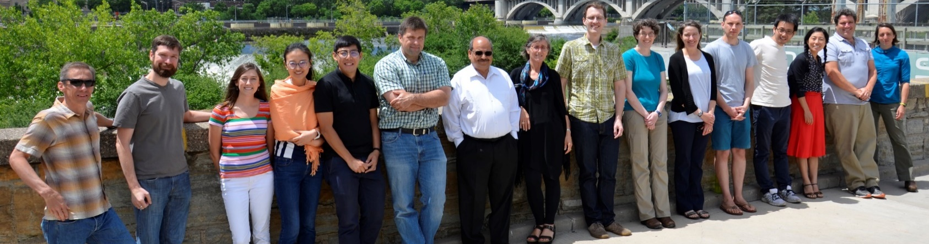





Acknowledgements
Collaborators:
Patrick Belmont, USU
Peter Wilcock, USU
Ben Hobbs, JHU
Carrie Jennings
Stephanie Day, NDSU
Wes Lauer, Seattle U
Barbara Heitkamp, UM
Jeff Marr, UM
Efi Foufoula-Georgiou, UI
Jacques Finlay, UM
Brent Dalzell, UM
Chris Lenhart, UM
Martin Bevis , UMD
Se Jong Cho, JHU/UM
Jon Czuba, UM
Christy Dolph, UM
Anna Baker, UM
Amy Hansen, UM
Sara Kelly, USU
Karthik Kumarasamy, USU
Nate Mitchell, UMD
Todd Campbell, ISU
Peter Hawthorne, UM
Cathy Kling, Cornell
Sergey Rabotyagov, UW
Funding provided by:
CSSR
Collaborative for
Sediment Source Reduction
None of our work would be possible without the tireless and meticulous work of innumerable state and local agency staff and the interest and support of south central Minnesotans.

